Slide 1
NMT SAE to AAVE
Technical comparison of different methods

Slide 2
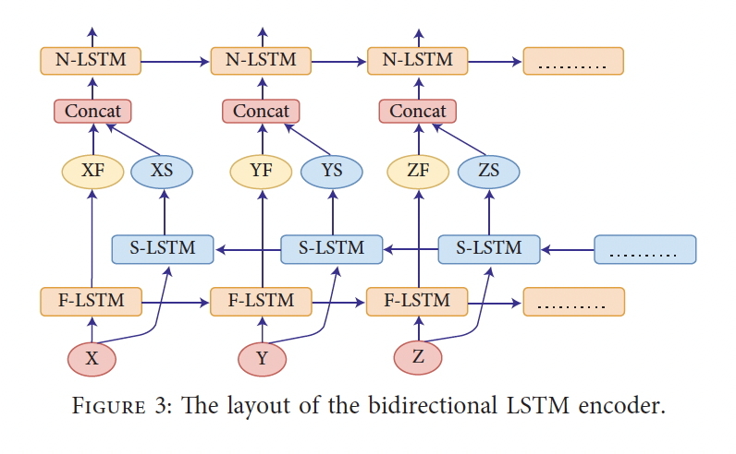
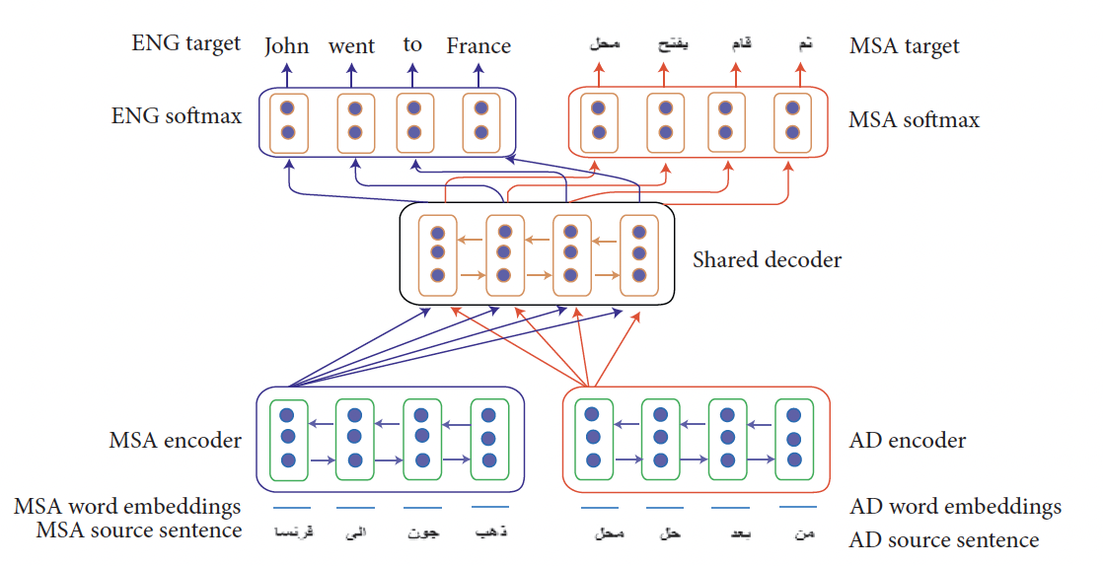
A Neural Machine Translation Model for Arabic Dialects That Utilises Multitask Learning (MTL)
Arabic Dialects to Standard Arabic
Recurrent neural network-based encoder-decoder neural machine translation model
https://github.com/laith85/AD_NMT
2 encoder – shared decoder

Slide 3
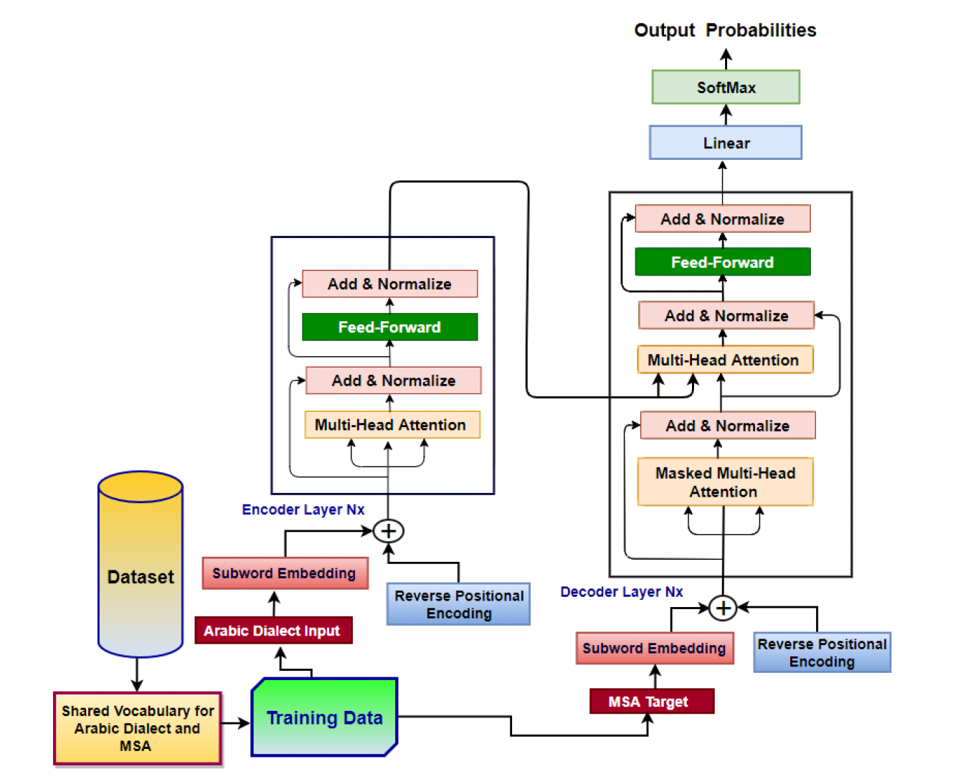
A Reverse Positional Encoding Multi-Head Attention-Based Neural Machine Translation Model for Arabic Dialects
Right to left text translation for this paper
Use of reverse positional encoding
Multi head attention

Slide 4
Low-Resource NMT: A Case Study on theWritten and Spoken Languages in Hong Kong
More about written translation
Transformer based architecture is used after comparing RNN-based models [1], CNN-based models [2], and transformers [3].
No exact architecture given
Use of attention mechanism

Slide 5
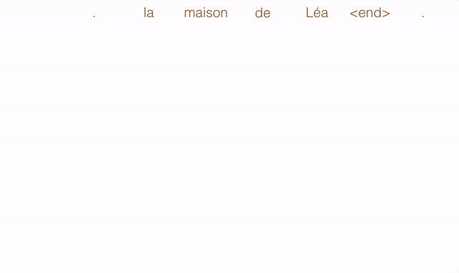
Machine Translation from Standard German to Alemannic Dialects
fine tuned Roberta
Use of attention heads

Slide 6
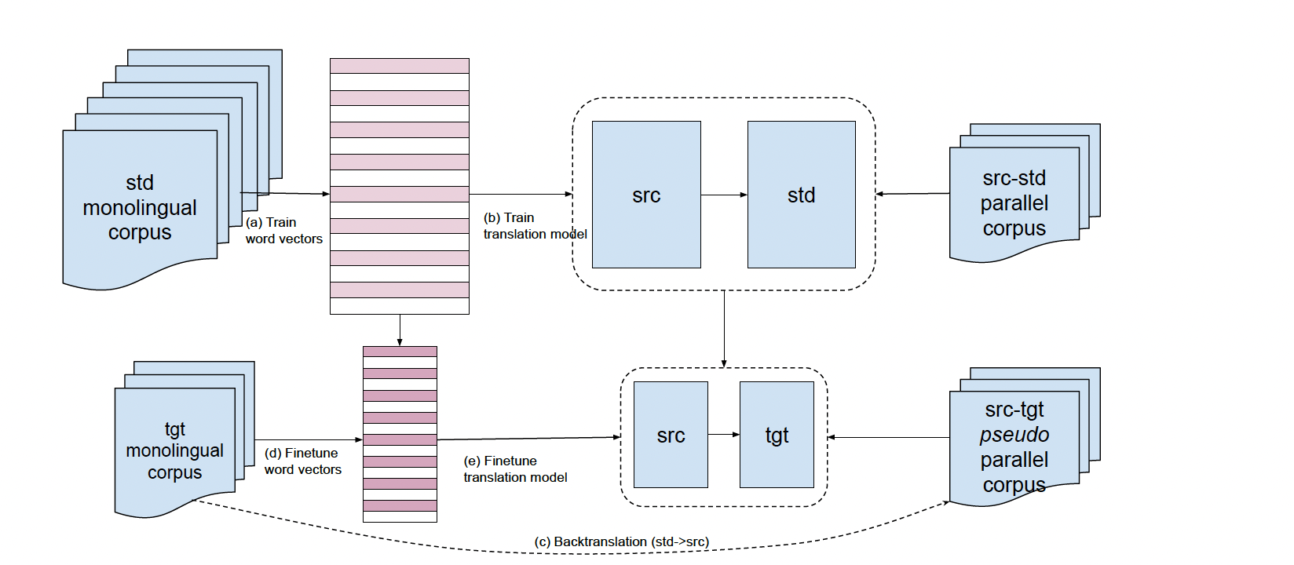
Machine Translation into Low-resource Language Varieties
No parallel corpus required
Talks about frame-work which is generalized
Based on back translation

Slide 7
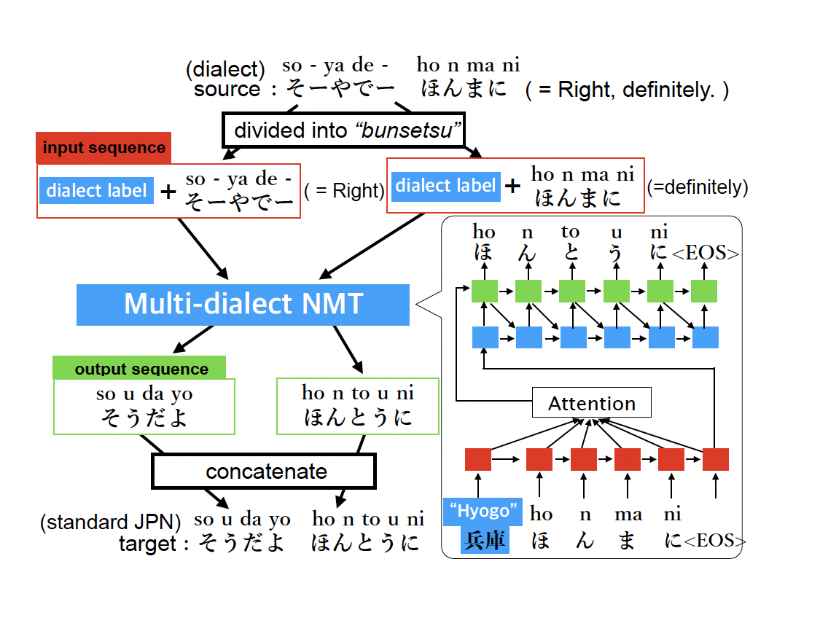
Multi-dialect Neural Machine Translation and Dialectometry
Phrase Units for proper sequencing.
Architecture
Encoder-decoder framework with a biLSTM network as the encoder and an LSTM network as the decoder.
The input text is segmented into bunsetsu (Japanese phrase units) and the output text is generated one bunsetsu at a time, using a phrase-based translation approach.
Multi-task learning approach, where it is trained to perform both dialect-to-standard and standard-to-dialect translation simultaneously.
Uses both character-level and phrase-level translation techniques to handle the differences between dialects and standard Japanese.

Slide 8
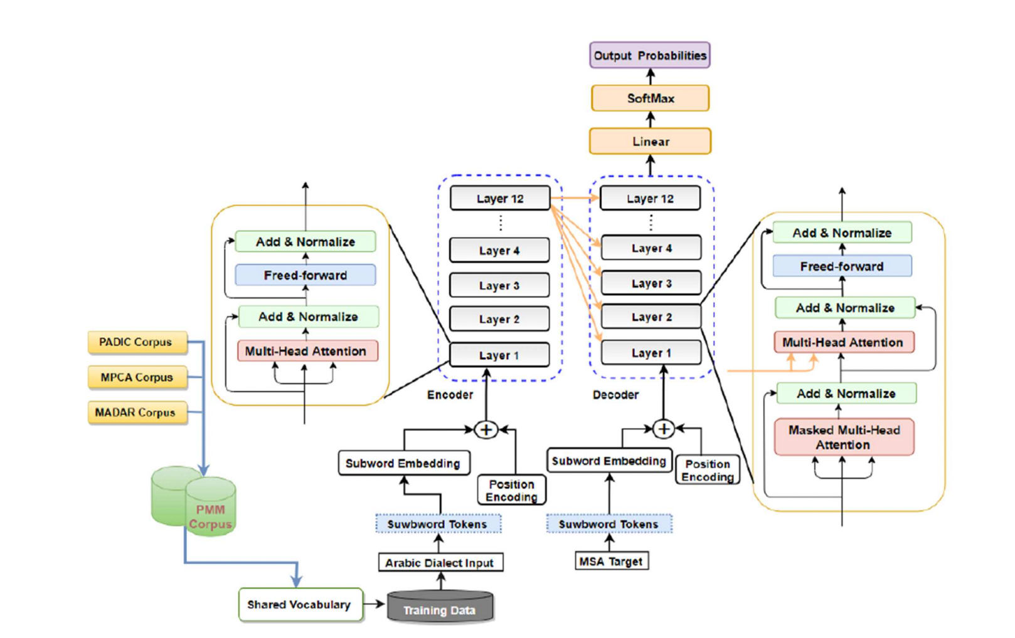
A Transformer-Based Neural Machine Translation Model for Arabic Dialects That Utilizes Subword Units
Sub-word Embedding
Use of shared vocabulary
Positional Encoding
Transformer based architecture

